Slide 1

Introduction to Cloud Computing
Cloud computing has revolutionized the way we access and utilize technology. It empowers businesses and individuals to harness the power of computing resources without the need for significant upfront investments.
MG
by MULA VARDHAN GOUD

Slide 2
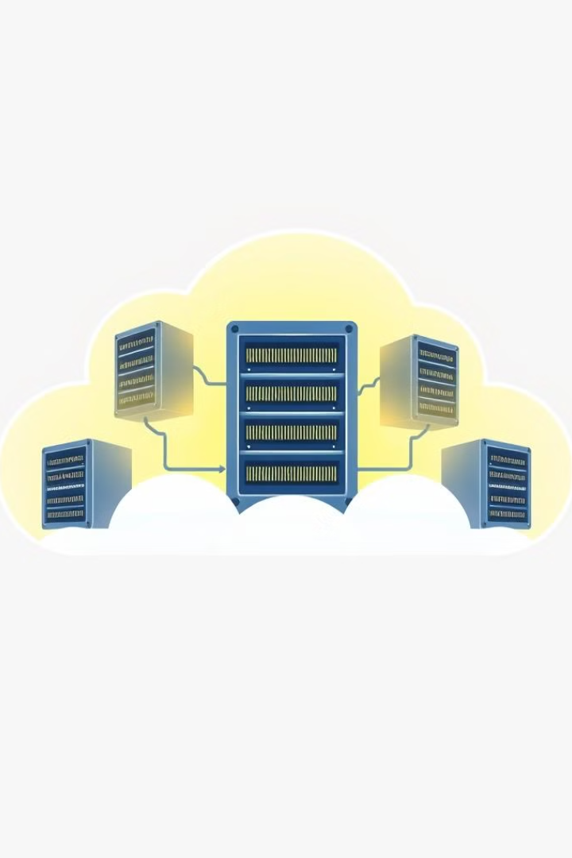
What is Cloud Computing?
Cloud computing refers to the delivery of computing services—including servers, storage, databases, networking, software, analytics, and intelligence—over the internet ("the cloud").
On-Demand Self Service
Broad Network Access
Users can access and provision computing resources as needed, without requiring human interaction from the service provider.
Cloud services are accessible from various devices and locations, leveraging the internet for connectivity.
Resource Pooling
The provider's resources are pooled to serve multiple consumers, dynamically allocated based on demand.

Slide 3

Benefits of Cloud Computing
Cloud computing offers a range of advantages for businesses and individuals.
1
Cost Savings
2
Scalability and Flexibility
Cloud computing eliminates the need for expensive hardware investments, allowing users to pay only for the resources they consume.
Cloud services can easily scale up or down to meet fluctuating demand, ensuring optimal resource utilization.
3
Increased Agility
Cloud computing enables rapid deployment and iteration of applications and services, promoting faster time-to-market.

Slide 4
Characteristics of Cloud Computing
Cloud computing exhibits several distinct characteristics that differentiate it from traditional IT infrastructure.
These features contribute to its widespread adoption and transformative impact across various sectors.
On-Demand Self-Service
Users can access cloud resources, such as computing power, storage, and software, without requiring human interaction with service providers.
Broad Network Access
Cloud services are accessible over a wide range of devices, including computers, tablets, and smartphones, enabling anytime, anywhere access.
Resource Pooling
Cloud providers pool resources to serve multiple consumers, allowing for efficient utilization and cost savings.
Rapid Elasticity
Cloud resources can be scaled up or down quickly and easily, accommodating fluctuations in demand and workload.
Measured Service
Cloud services are metered and billed based on actual usage, providing transparency and accountability for resource consumption.

Slide 5
Cloud Computing Service Models (IaaS, PaaS, SaaS)
Cloud computing service models offer varying levels of control and management responsibilities.
IaaS (Infrastructure as a Service)
PaaS (Platform as a Service)
SaaS (Software as a Service)
Offers a platform for developing, deploying, and managing applications, including runtime environments, databases, and development tools.
Delivers fully functional applications accessible over the internet, with the provider managing all aspects of the software.
Provides access to fundamental infrastructure components, such as servers, storage, and networking.

Slide 6
Applications of Cloud Computing
Cloud computing offers a wide range of applications across various industries, from small businesses to large enterprises.
These applications leverage the benefits of cloud computing to improve efficiency, agility, and innovation.
Business Applications
Cloud-based solutions enable businesses to streamline operations, manage data effectively, and enhance customer experiences.
Examples include customer relationship management (CRM), enterprise resource planning (ERP), and collaboration tools.
Personal Applications
Individuals benefit from cloud services for storage, productivity, entertainment, and communication.
Popular examples include online storage services like Dropbox and Google Drive, email services like Gmail, and streaming platforms like Netflix.

Slide 7
Industry Examples
Cloud computing is used across various sectors, such as healthcare, finance, and education.
In healthcare, cloud services enable secure storage and sharing of patient data, telehealth platforms, and remote diagnostics.
The financial industry leverages cloud computing for online banking, payment processing, and risk management.
Educational institutions utilize cloud platforms for online learning, collaborative tools, and data analytics.

Slide 8




Cloud Computing Deployment Models (Public, Private, Hybrid)
Cloud computing deployment models determine the ownership and control of the cloud infrastructure.
Public Cloud
Private Cloud
Hybrid Cloud
Shared infrastructure owned and operated by a third-party provider, offering high scalability and cost-effectiveness.
Dedicated infrastructure owned and managed by the organization, providing enhanced security and control but potentially higher costs.
A combination of public and private clouds, allowing organizations to leverage the benefits of both models.

Slide 9

Cloud Computing Security and Compliance
Ensuring data security and compliance is paramount in cloud environments.
Data Encryption
Protecting data in transit and at rest through encryption techniques.
Access Control
Restricting access to sensitive data based on user roles and permissions.
Compliance Standards
Adhering to industry regulations, such as HIPAA, GDPR, and PCI DSS, to ensure data privacy and security.

Slide 10





Advantages
Cloud computing offers numerous advantages that can significantly benefit businesses.
Cost-Effective
Scalability
Global Reach
Collaboration
Eliminates the need for upfront hardware investments and allows for pay-as-you-go pricing.
Easily scale resources up or down to meet fluctuating demand, ensuring optimal resource utilization.
Cloud services are accessible from various devices and locations, leveraging the internet for connectivity.
Cloud platforms facilitate collaboration and data sharing among teams and users.

Slide 11

Disadvantages
While cloud computing offers many benefits, it's important to consider its potential drawbacks.
1
Security Concerns
2
Vendor Lock-In
3
Internet Dependence
Data security and privacy are paramount in cloud environments, and organizations must implement robust security measures.
Organizations may face challenges transitioning to different cloud providers due to vendor-specific technologies or data dependencies.
Cloud services rely on internet connectivity, and outages or network issues can disrupt operations.

